Slide 1
PHY CH 33

Slide 2
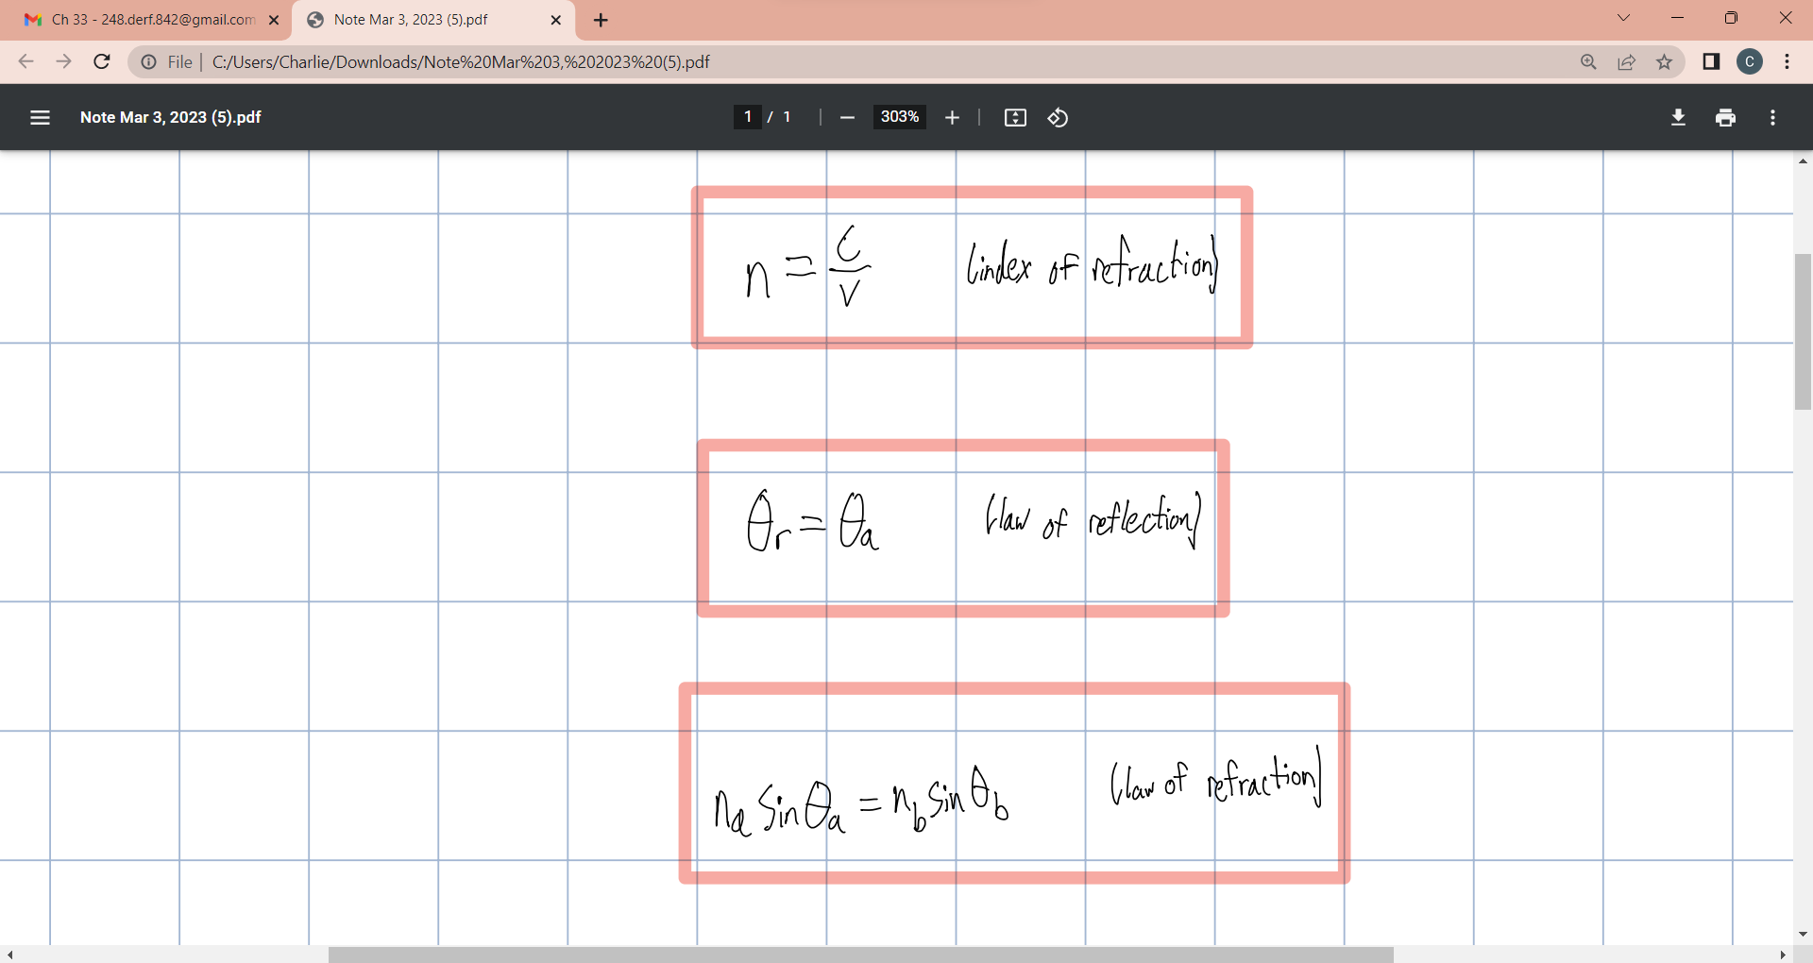

Slide 3
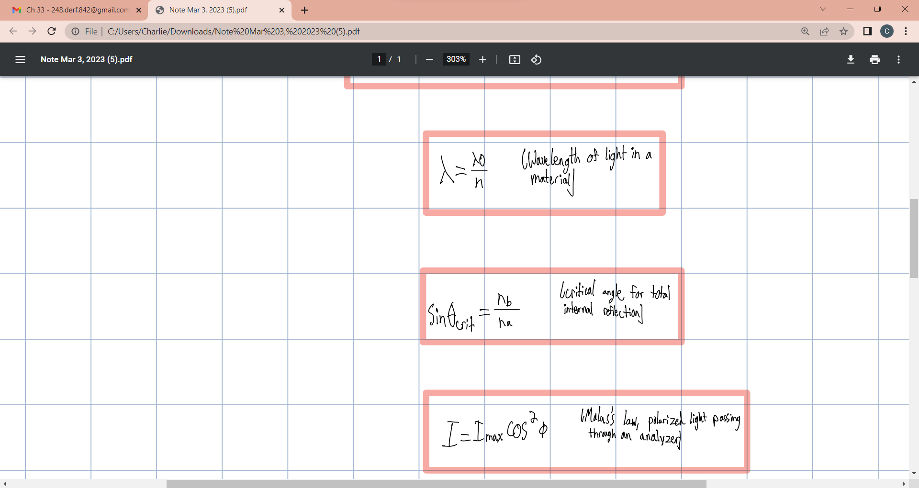

Slide 4
